Slide 1
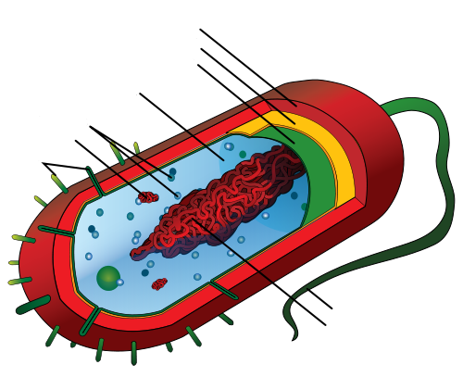
Capsule
Cell Wall
Plasma membrane
Cytoplasm
Ribosomes
Plasmid
Pili
Bacterium Flagellum
Nucleoid

